Slide 1
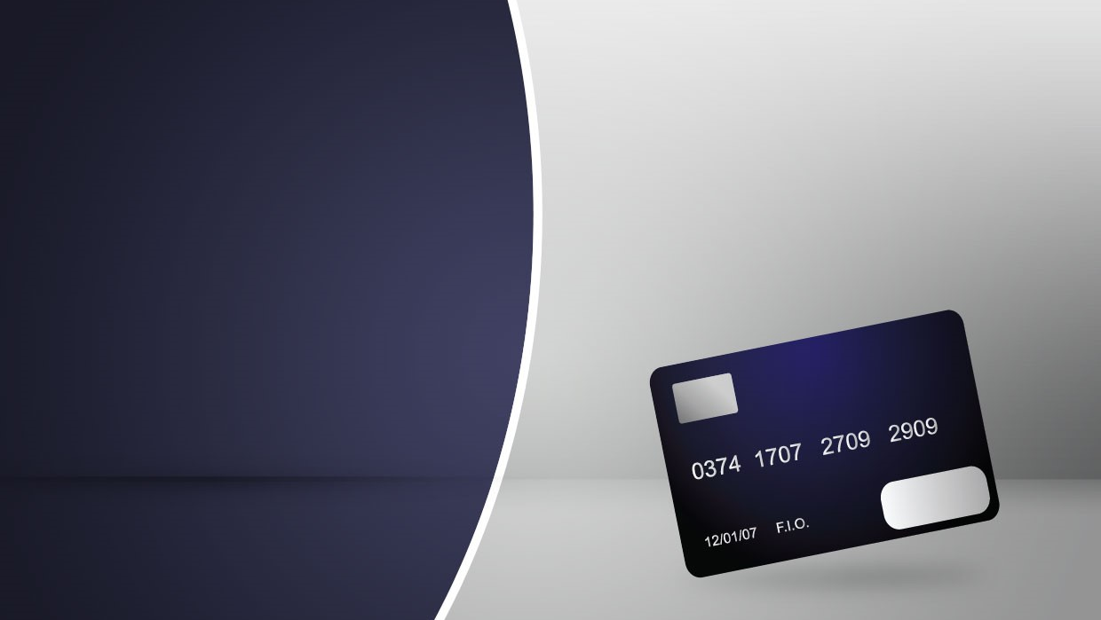
Mitron Bank's Strategy Expansion
Decoding Customer Expenditure Trends and Market Dynamics through Data Insights
Presented by
Sidhant Bisht

Slide 2
Table of Content
Introduction
Purpose of Analysis
Data Information
Data Model
Dashboard
Key Insights
Conclusion

Slide 3

Introduction
Mitron Bank is a legacy financial institution headquartered in Hyderabad. They want to introduce a new line of credit cards, aiming to broaden its product offerings and reach in the financial market.

Slide 4
Purpose of Analysis
Broaden Mitron Bank’s product offerings and increase its reach in the financial market.
To understand Customer behaviors and its need.
To Identify High Value Customer Segments.
Utilize insights for informed decision-making, guiding the bank's strategy in the new credit card expansion project.

Slide 5
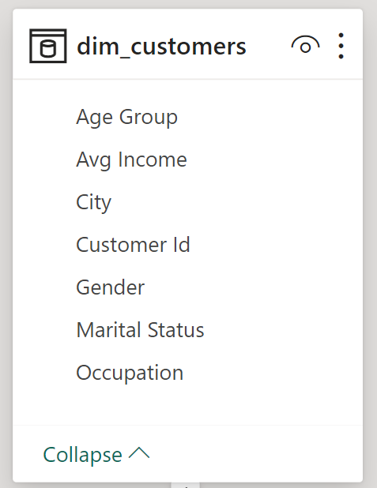
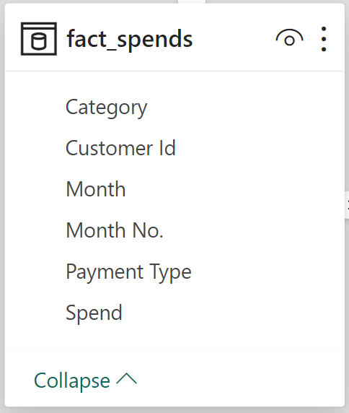
Data Information

Slide 6
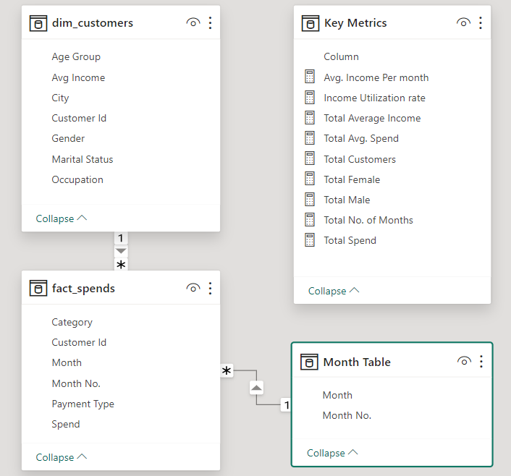
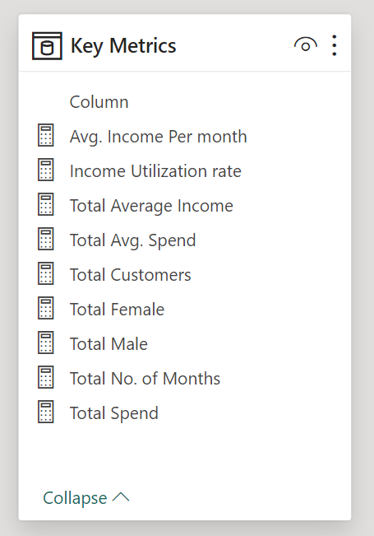
Data Model

Slide 7
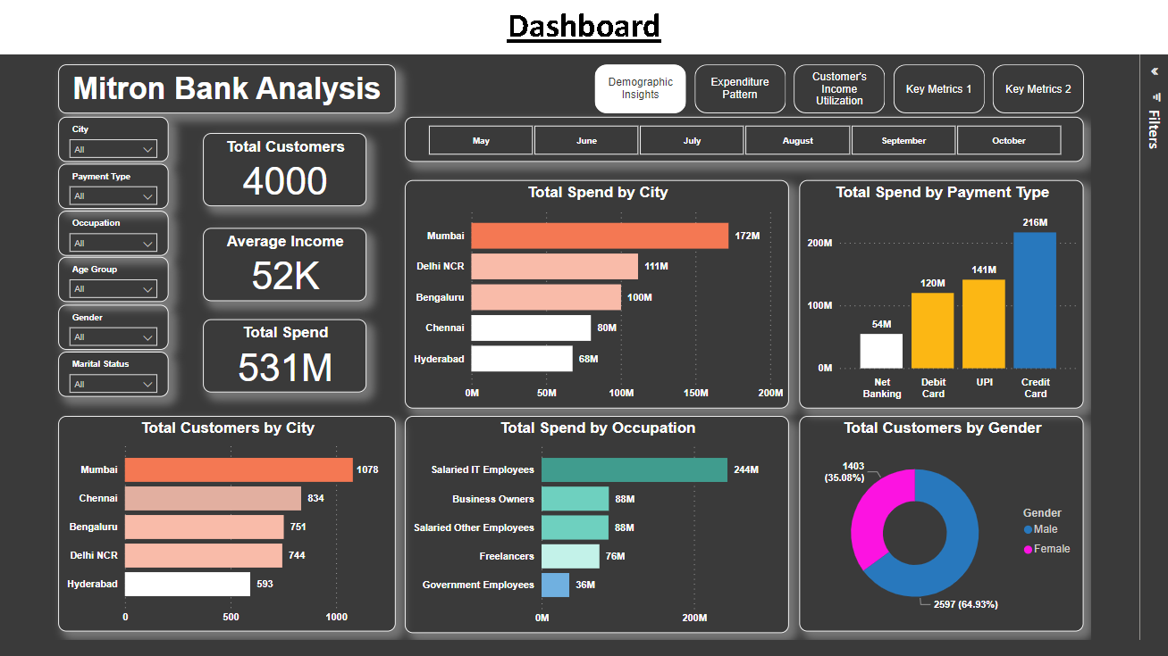

Slide 8
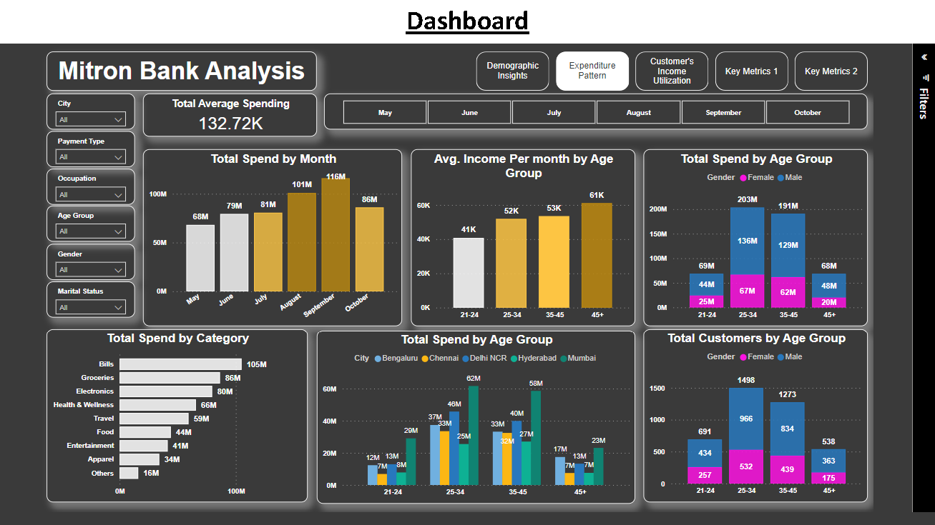

Slide 9
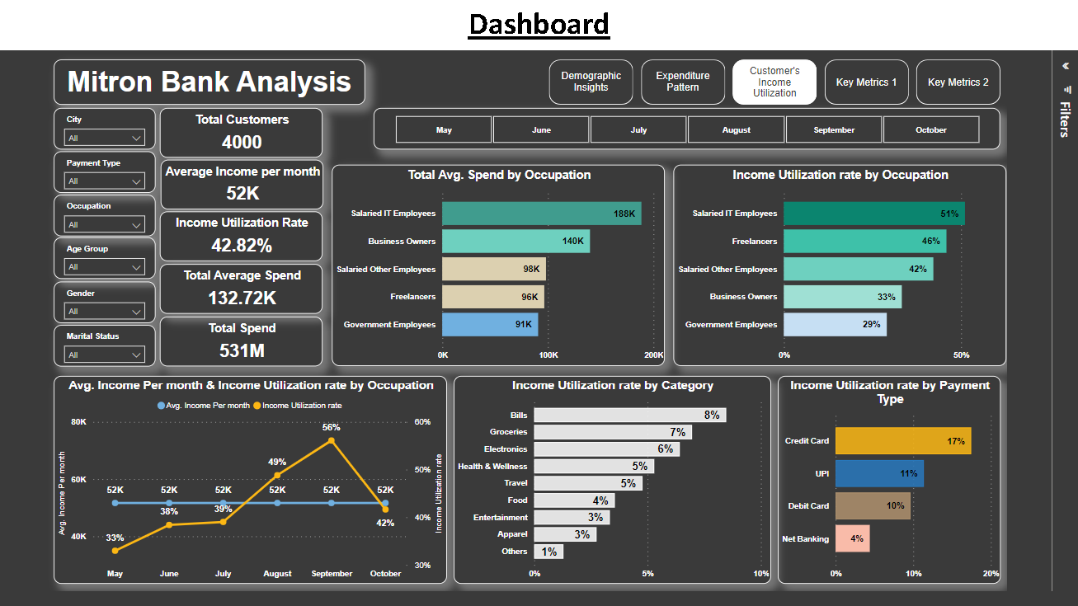

Slide 10
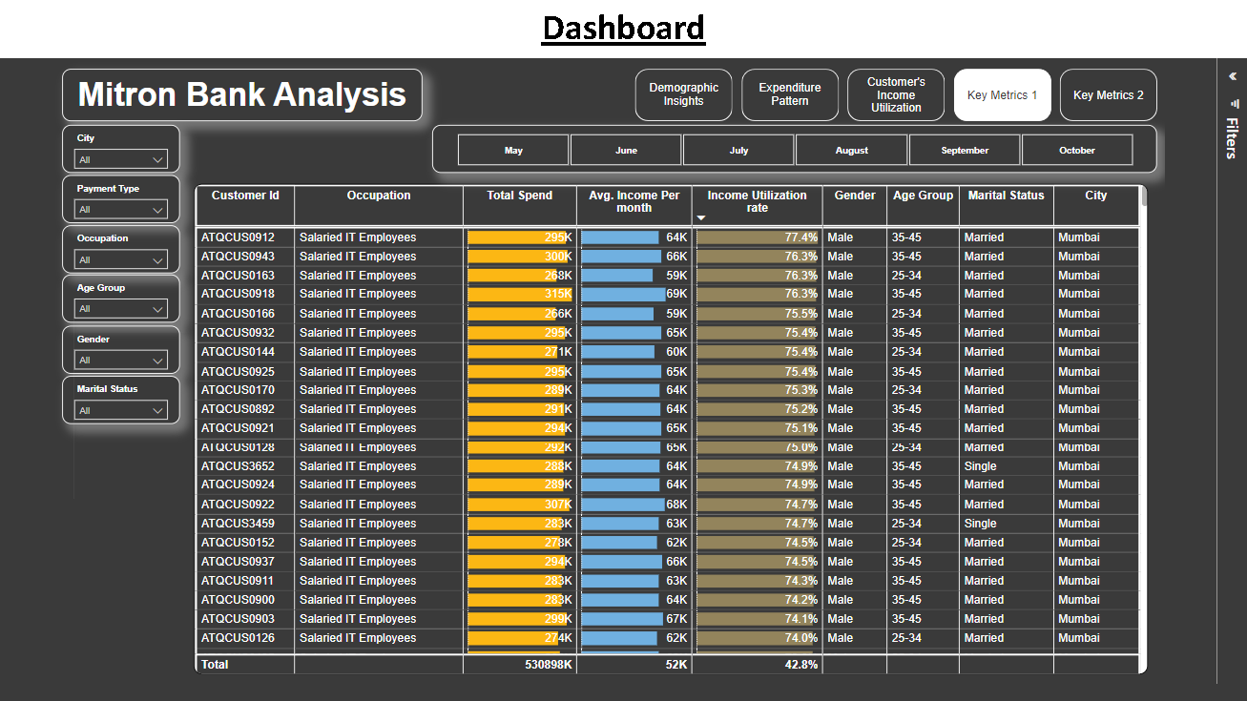

Slide 11
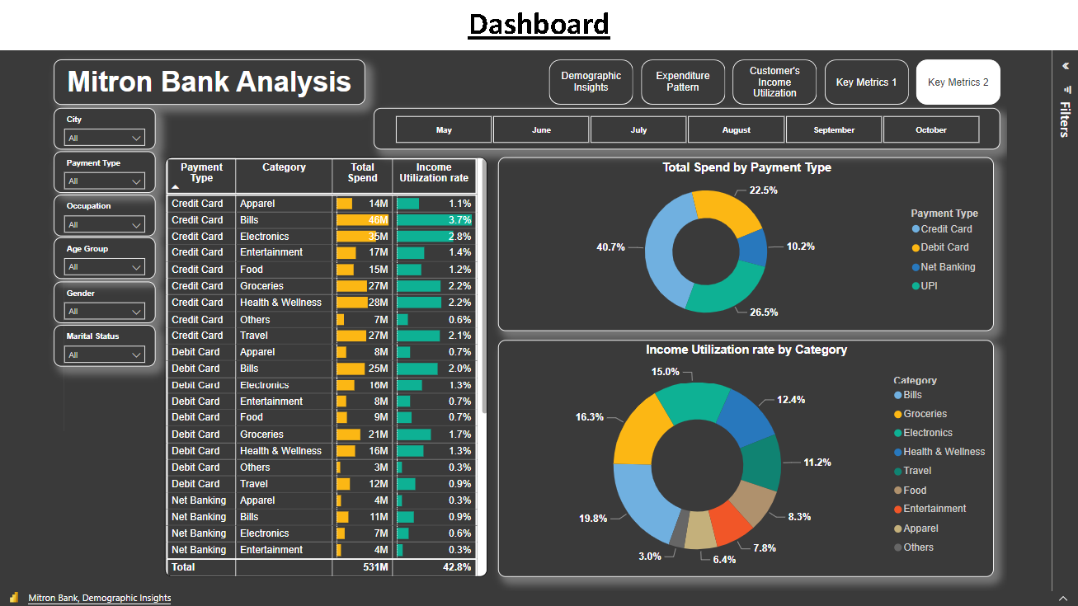

Slide 12
Key Insights
Demographic Insights
Expenditure Pattern
Customer’s Income Utilization

Slide 13
Demographic Insights
In Mitron Bank’s dataset, there are 4000 customers, 2597 are males & 1403 are females.
The prime age group of 24-34 years old constitutes the highest customer count.
Mumbai has the highest no. of customers with 1078, followed by Chennai with 834 customers.
Salaried IT employees emerge as the most prominent potential customer segment.
In terms of expenditure, Mumbai has the highest customer spending, followed by Delhi NCR.
Most of the Customers make payment through Credit Card.
Mumbai based customer make highest payment through both Credit and Debit bank card.

Slide 14
Expenditure Pattern
Male customers exhibit higher expenditures to their female counterparts.
Age group 25-34 emerges as the highest spender, followed by age group 35-45 as second.
Customer spends major portion of its income towards bills, groceries, and electronics.
Salaried IT employees stand out as the highest spenders in various categories, including bills, groceries, electronics, and health and wellness.
Align credit card features with the months (August & September) when customers spend the most to maximize customer engagement.

Slide 15
Customer’s Income Utilization
Higher the average income utilization rate %, the Customer is more likelihood to use credit cards.
Salaried IT employees has the highest average income per month among all others occupation.
Salaried IT employees has the highest average income utilization Rate 51%, followed by Freelancers with 46% as second.
Customer spends major portion of its income towards bills, groceries, electronics and Health & Wellness.
Based on Occupation, Both Salaried IT employees & Freelancers make major portion of Payment through credit card.
Align credit card features with peak spending months like August and September, which have the highest average income utilization rates, increasing the likelihood of customer engagement.
Mumbai has 51.43% average income utilization rate, followed by Delhi NCR with 48.03% as second.

Slide 16
Conclusion
Focus marketing efforts on the 25-34 & 35-45 age groups due to their high credit card usage based on Mumbai and Delhi NCR regions.
Regularly update promotions and offers to align with evolving consumer behavior.
Explore partnerships or introduce specialized rewards or discounts to boost spending in bills, groceries, electronics, food, health and travel categories to further enhance credit card usage.
Craft specialized (loyalty programs or perks) credit card offers for Salaried IT employees & freelancers, considering their higher usage.
Introduce exclusive benefits for Salaried other employees and Business owners to increase their average income utilization.
Align credit card features with peak spending months like August and September.
Plan Seasonal promotions around July & October months to further maximize customer engagement.

Slide 17
Thank You
Contact Information
Dashboard: https://www.novypro.com/project/mitron-banks-strategic-expansion
Portfolio: https://www.novypro.com/profile_projects/sidhantbisht
Linkedin: https://www.linkedin.com/in/sidhant-bisht-5a4633195
Presented by
Sidhant Bisht

